Slide 1

Predicting customer buying behavior
Chan Man Tze

Slide 2
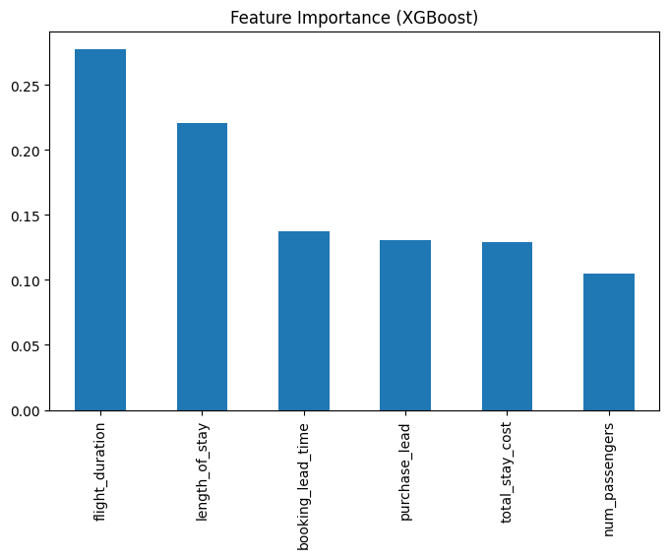
Predictive Model to Understand Factors that Influence Purchasing Behavior
We have trained the data set with Random Forest and XGBoost classifier models, after evaluating both models, the best model is XGBoost and this model received:
ACCURACY: 85.06
AUC score: 0.6505
Top 5 features:
flight_duration
length_of_stay
booking_lead_time
purchase_lead
total_stay_cost

